Slide 1
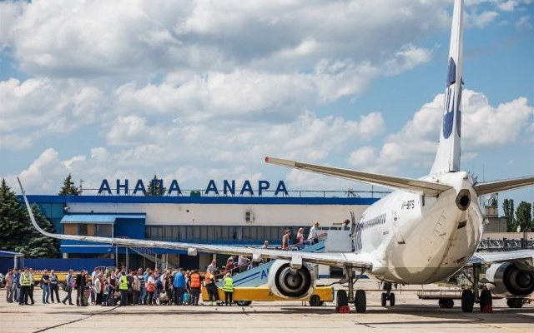
LogoType
Project 4:
Flights profitability
From Anapa
Tommy Sheinberg

Slide 2
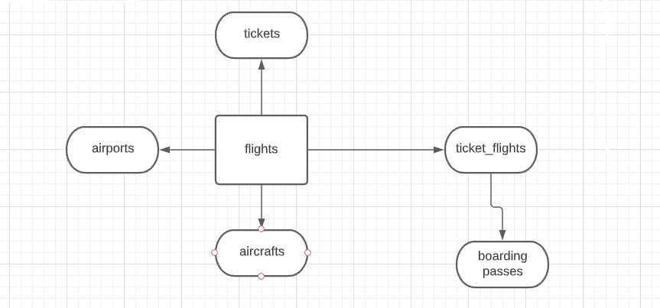
The structure of db

Slide 3
Database presentation – description
To prove and to represent profitability of flights from Anapa airport, I based on the next
tables:
‘flights’ –this is a main table that includes whole information about flights, there
I had to set him to the rest tables – ‘tickets’ for calculating, ‘aircfrats’, ‘airports’ and
‘ticket_flights’ for amount tickets on two flights from ANAPA (there weren’t 9 flights
to NQZ) .
In order to complete the missing data and represent occupancy of flights I based
on additional table ‘boarding_passes

Slide 4
Database presentation –flights from AAQ
The aircrafts which flew from ’AAQ’ on winter season:
Boeing 737.
Super Jet
3. In Conclusion From ‘AAQ’ were done 118 flights – 59 by ‘Super Jet’ to Belgorod
and 59 by Boeing 737 to Moscow destination.
Additional Data:
Capacity with all fare conditions Boeing 737: 118 – economy and 12 – business: 130
Capacity with all fare conditions Sukhoi Superjet-100: 85 – economy 12 – business: 97

Slide 5
Flight effectiveness from Anapa
Average Occupancy Per flight by fare Condition business/economy | Fuel Consumption L/h, L/min, cost of fuel per litre in euro | Destination | Flight/Aircraft
653/4668 in sum = 5321 passengers | 1750/h, 29.6/min, 0.4 | Belgorod | PG0480/SuperJet
620/6054in sum = 6674 passengers | 2500/h, 41.66/min | Moscow | PG0252/Boeing 737-300
Cost for SuperJet flight (only fuel cost) per min = 29.6*0.4 = 11.84 euro
Cost for 737-300 flight (only fuel cost) per min = 41.6*0.4 = 16.64 euro

Slide 6
Summary & rest Data
Effectiveness index Index of occupancy* cost for flight per min | Index of occupancy Full capacity/occupancy | Destination | Flight/Aircraft
0.92*11.84 = 10.89 | 90/97 = 0.92 | Belgorod | PG0480/SuperJet
0.86*16.64 = 14.46 | 113/130 = 0.86 | Moscow | PG0252/Boeing 737-300
The effectiveness index for Superjet higher then 737-300

Slide 7
Summary to management board
Flights to Belgorod are more lucrative than flights to Moscow and yield higher profits.
SU's fuel consumption is lower than BOEING's, and the capacity of
flights to Moscow is also commensurate with capacity.
Therefore, it is recommended to operate the SU9 aircraft for Moscow as well.
For a good calculation I also needed the reduction of the aircraft which includes the
cost of maintenance and the cost of spare parts, another variable needed for this
calculation is the cost of the flight crews , air flight time and ground waiting hours
are very important for the calculating.
5. Next flights were with low profitability to Moscow direction: 136122, 136360
To Belgorod direction: 136620, 136642, 136807, 136844.

Slide 8
Requests – for amount occupancy
select count(passenger_id), fare_conditions, flight_no
from dst_project.tickets
join dst_project.ticket_flights on ticket_flights.ticket_no = tickets.ticket_no
join dst_project.flights on ticket_flights.flight_id = flights.flight_id
WHERE departure_airport = 'AAQ' and (date_trunc('month', scheduled_departure) in ('2017-01-01','2017-02-01', '2017-12-01'))
AND status not in ('Cancelled')
group by fare_conditions, flight_no

Slide 9
Requests – for amount flights on SU9/737-300
select count(flight_id), flight_no
from dst_project.flights
WHERE departure_airport = 'AAQ' and (date_trunc('month', scheduled_departure) in ('2017-01-01','2017-02-01', '2017-12-01'))
AND status not in ('Cancelled') and aircraft_code = 'SU9'
group by flight_no

Slide 10
Requests – for amount of seats in 737-300
select
fare_conditions, count(fare_conditions)
FROM
dst_project.seats s
where aircraft_code='733'
group by fare_conditions

Slide 11
Requests – for amount flights on SU9
select count(flight_id), flight_no
from dst_project.flights
WHERE departure_airport = 'AAQ' and (date_trunc('month', scheduled_departure) in ('2017-01-01','2017-02-01', '2017-12-01'))
AND status not in ('Cancelled') and aircraft_code = 'SU9'
group by flight_no

